Slide 1

Library Android Application
-- Group members:
Jay Doshi
Ronakkumar Mangroliya
Vimal Radadiya
Krushal Dobariya
Guided By,
Sajit Khadka

Slide 2
Project Overview
The project aims to simulate a basic Smart Library Android Application to facilitate efficient book issuance, particularly addressing the challenges faced by university users in finding specific tools.
The Android mobile application simplifies the process of locating and issuing books, making it more user-friendly for approximately 80% of Android users.
The coding level focuses on minimizing code complexity by employing efficient algorithms, ensuring optimal performance.
All data is stored in a Firebase Database, providing real-time synchronization and ensuring data persistence even after restarts. Firebase Real-time Database is a cloud-hosted NoSQL database offering real-time updates through a single API.

Slide 3
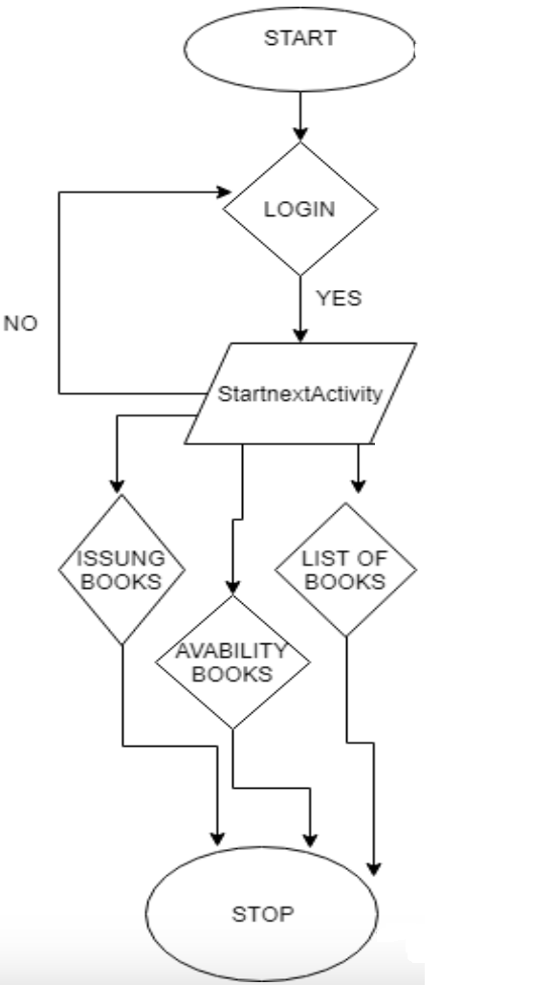
Flow of Project Student Module

Slide 4
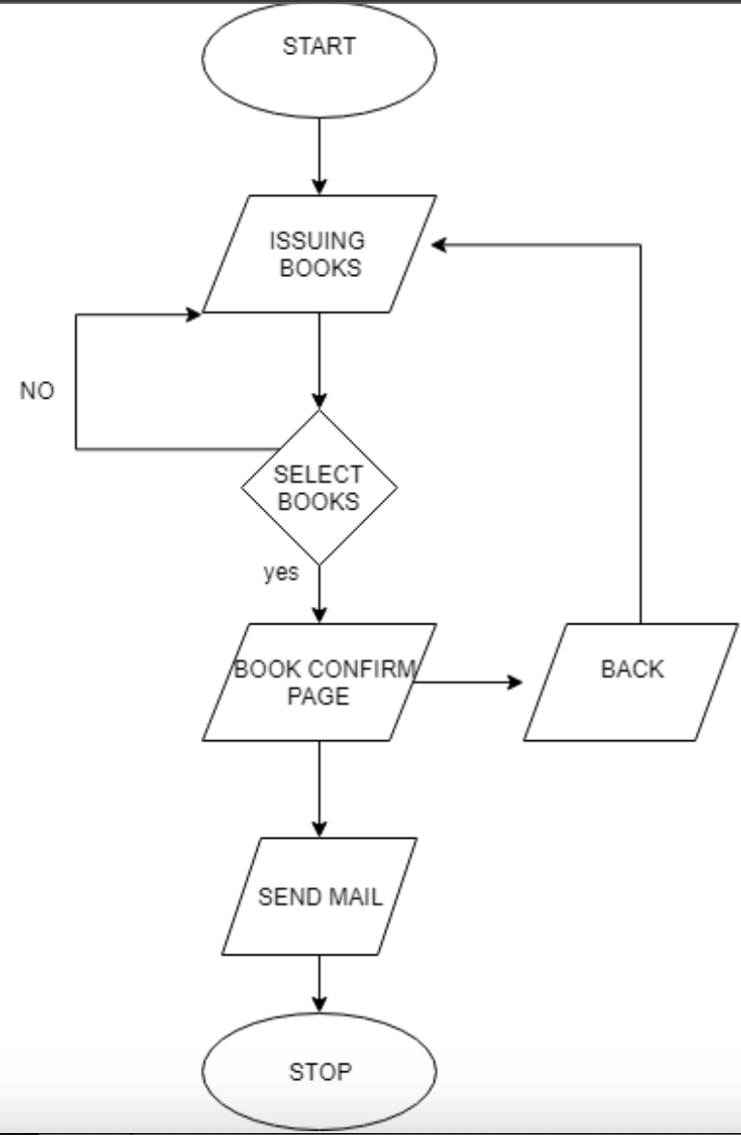
Flow of Project Issuing Books

Slide 5
Major Functionality
Utilizes students' email addresses for secure logins. Enhances user experience with a familiar and personalized authentication method.
Allows users to check the real-time availability of books in the library. Provides an intuitive interface for users to easily identify and locate available books.
Facilitates book issuance using the student's email for identification. Sends email notifications to the admin for both book issuances.

Slide 6
Module Specification
Firebase Authentication
Real-time Firebase Database
Android Studio
Real-time Data Updates
Designs for future scalability and expansion

Slide 7
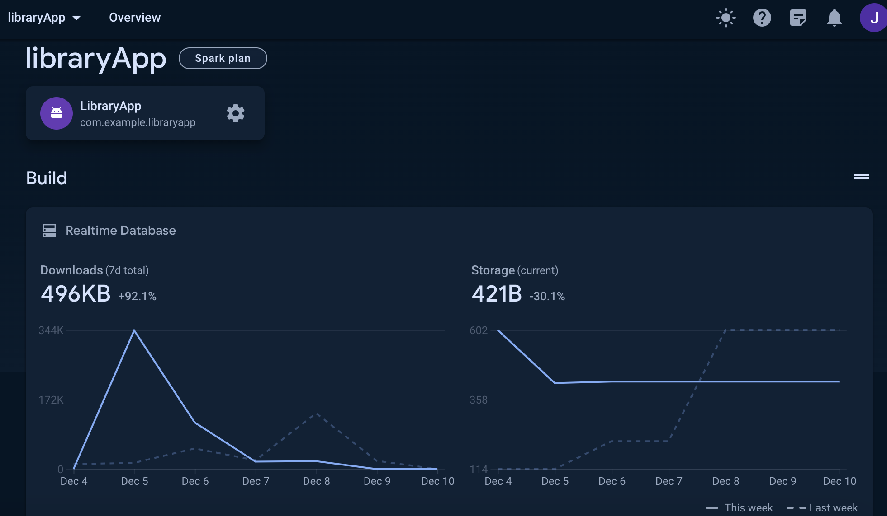
Snapshots of Project Firebase Architecture 1.1

Slide 8
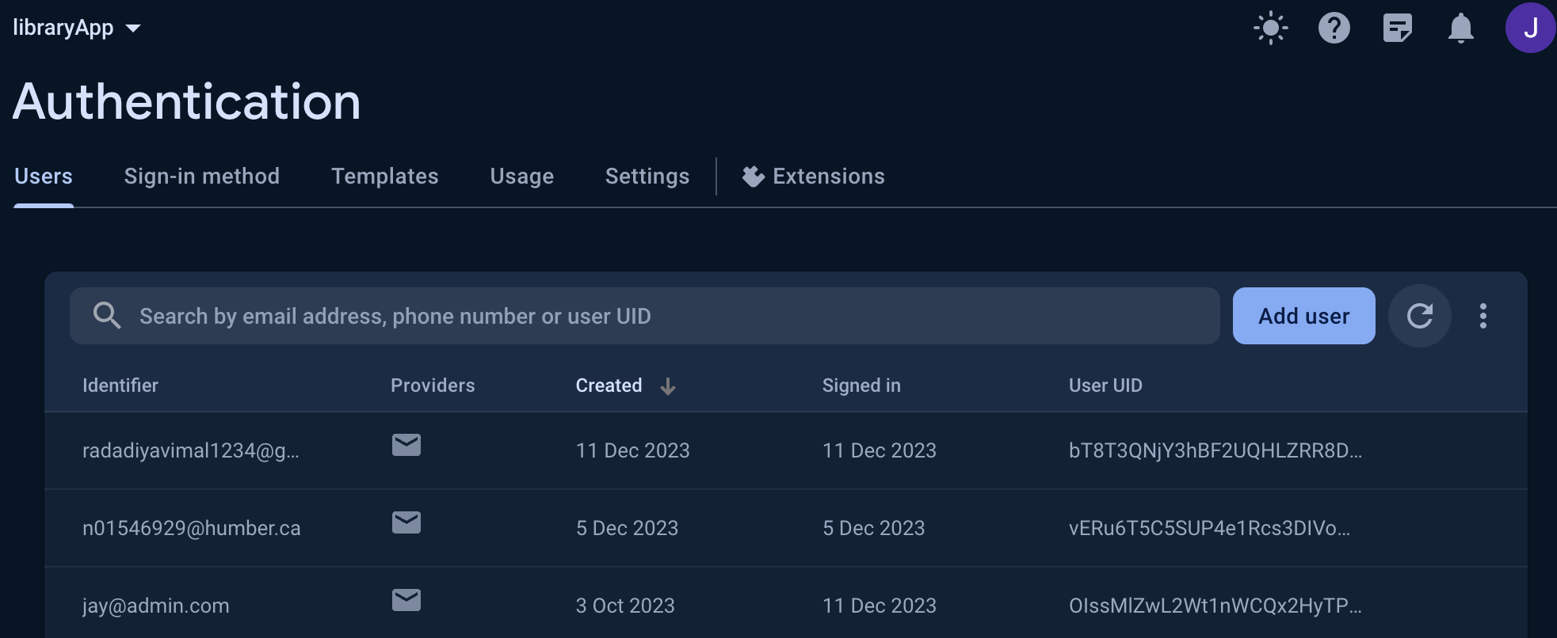
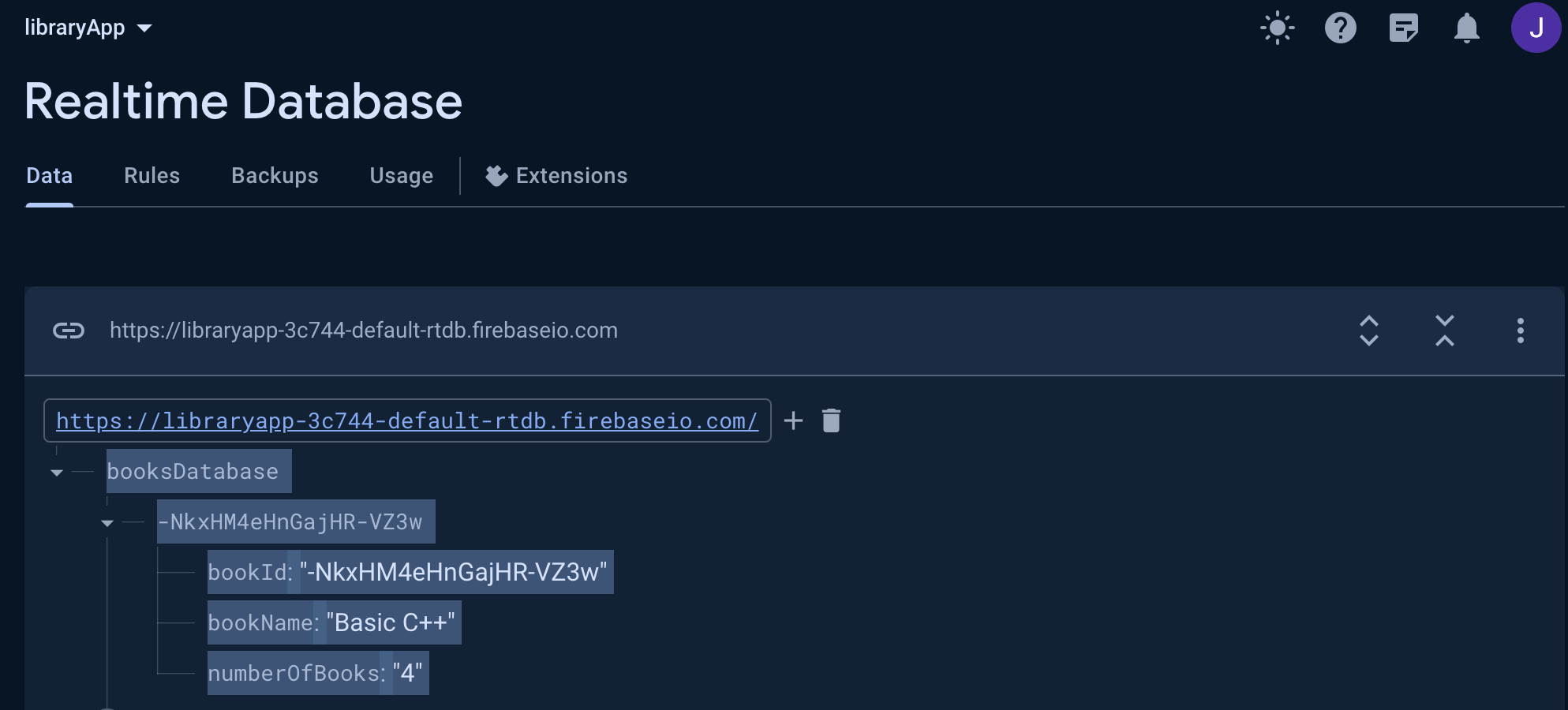
Snapshots of Project Firebase Architecture 1.2

Slide 9
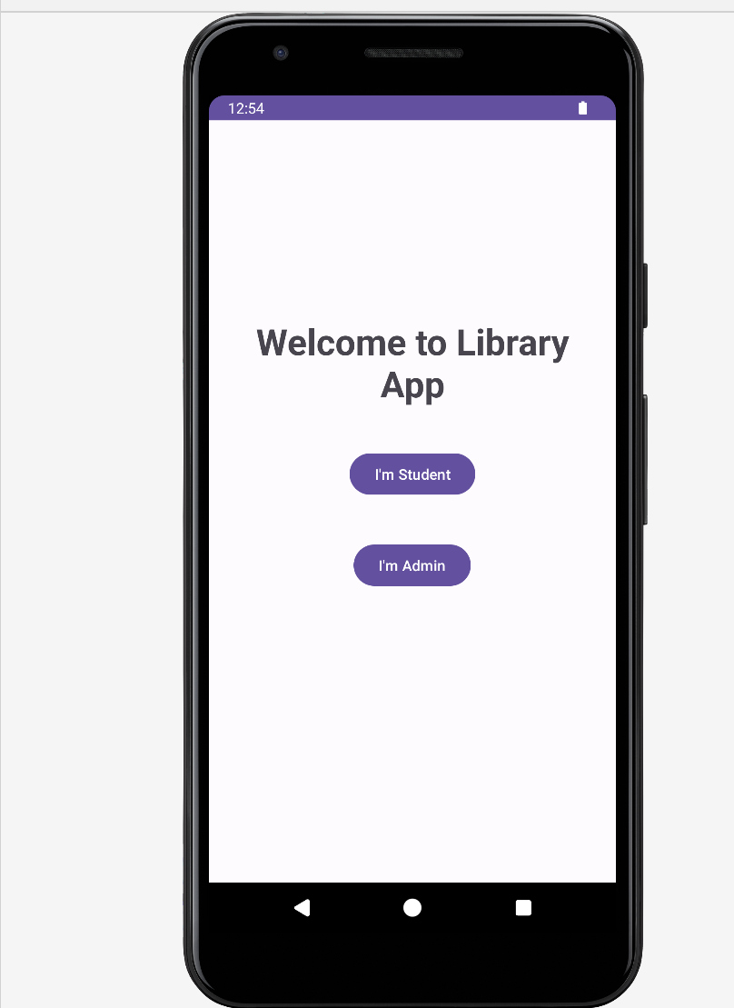
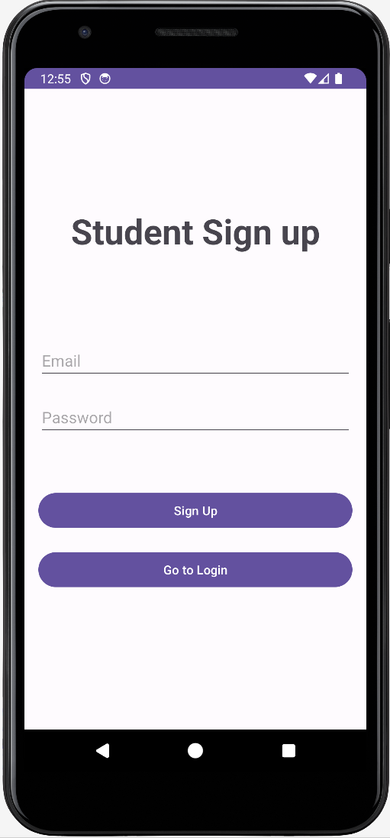
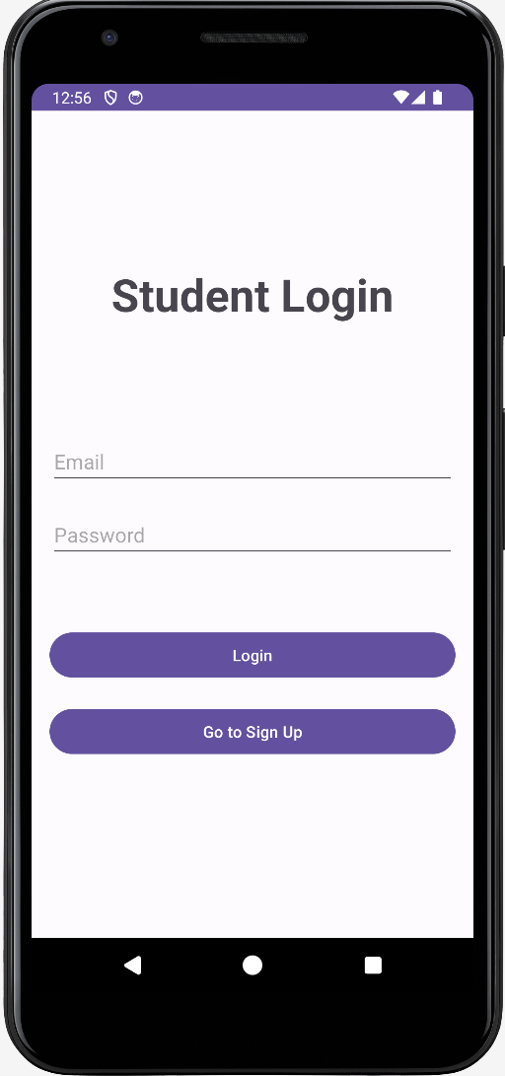
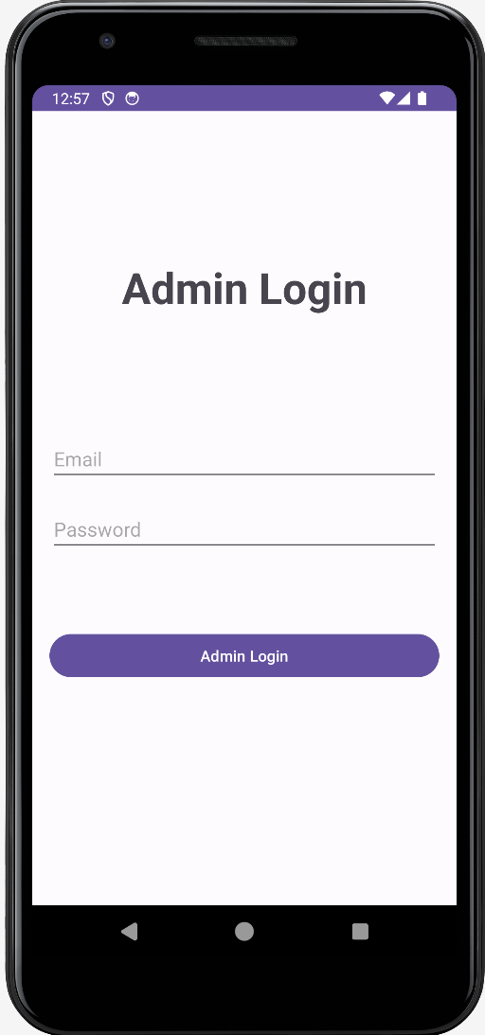
Snapshots of Project Main Screens of 2 modules (Student and Admin)

Slide 10
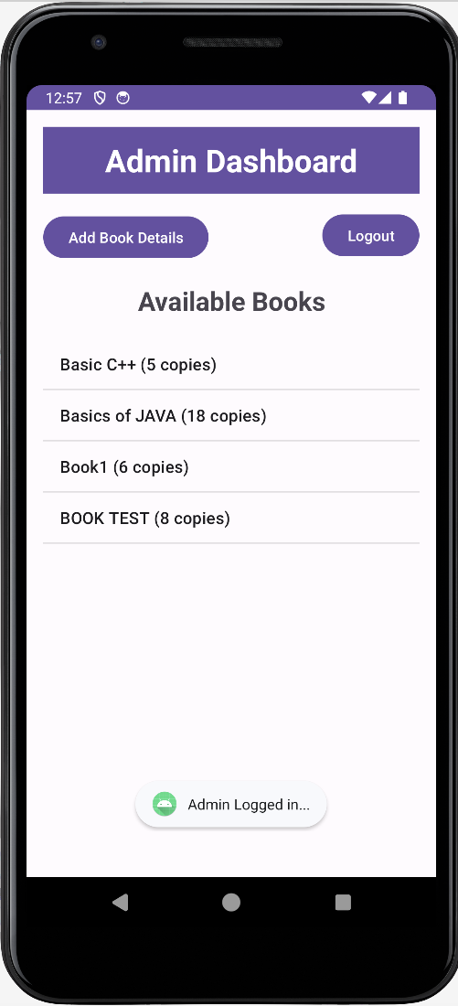
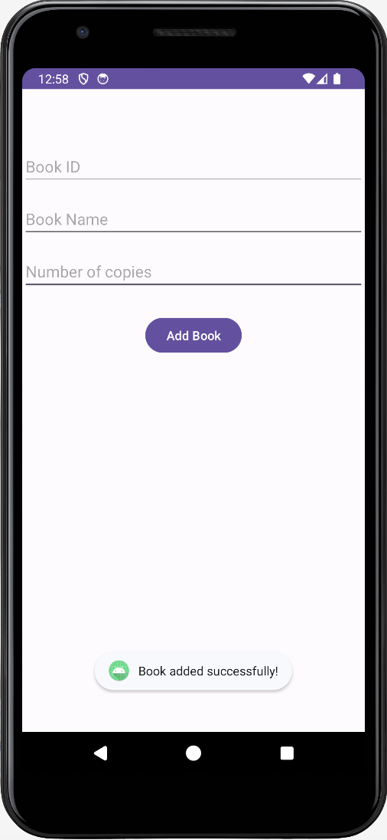
Snapshots of Project Admin Module Screen

Slide 11
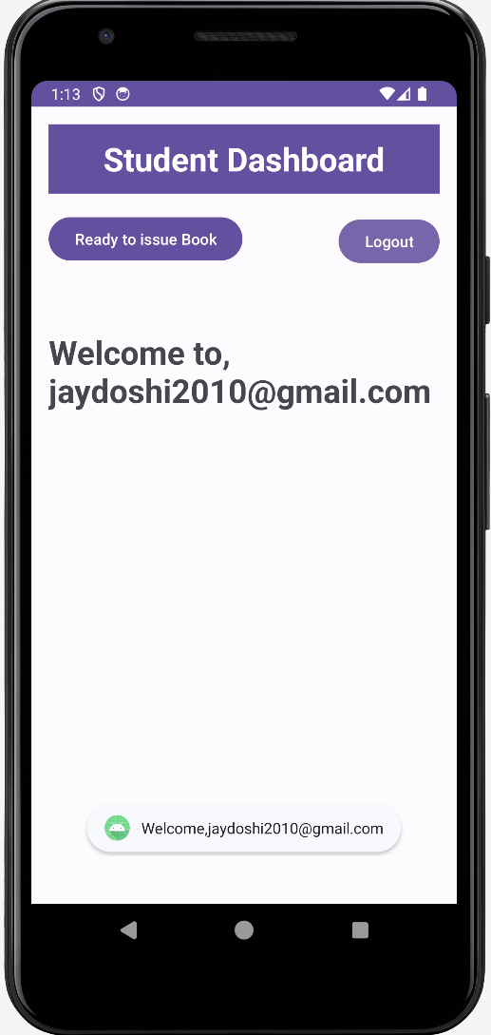
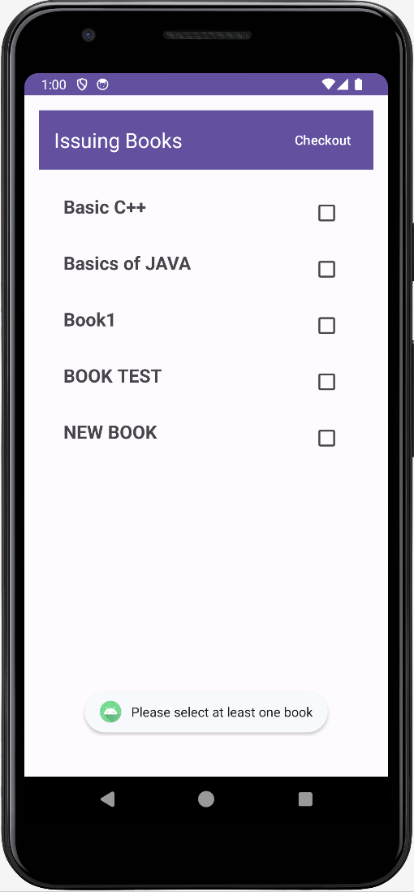
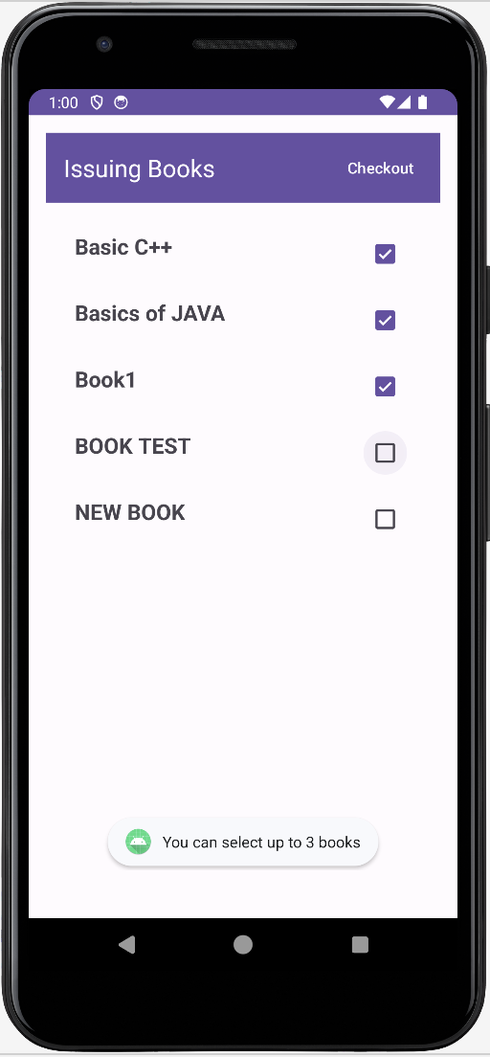
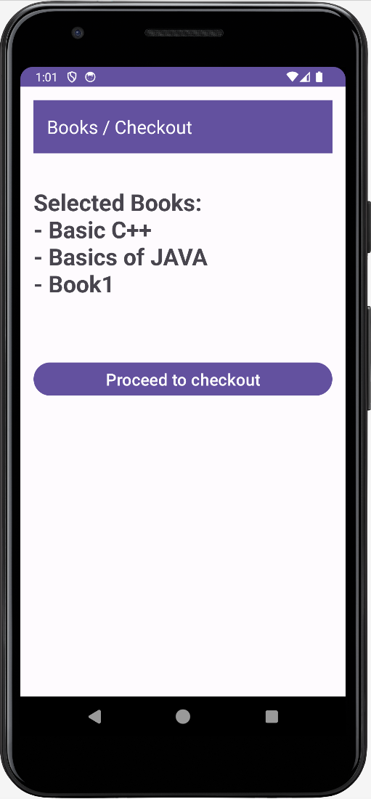
Snapshots of Project Student Module Screen

Slide 12
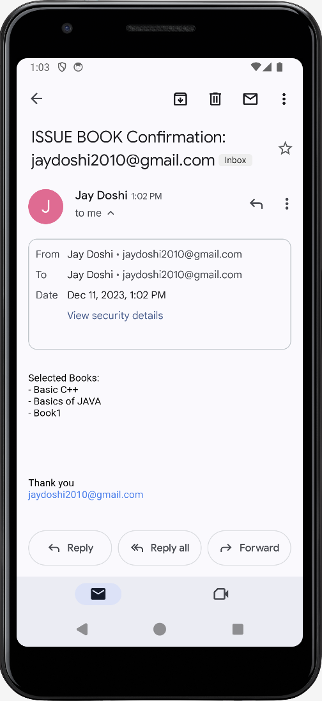
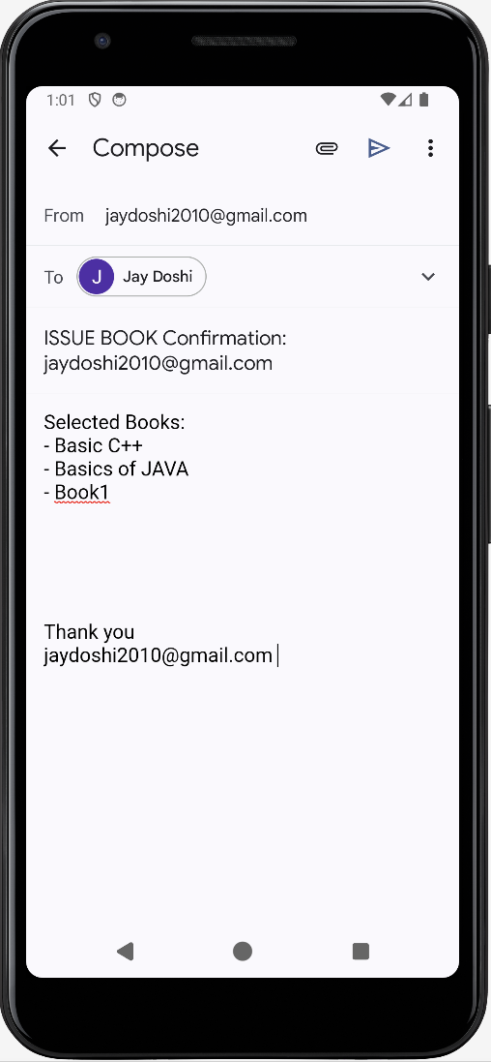
Snapshots of Project Email Screen (After Proceed to checkout button pressed)

Slide 13
Conclusion
Our team proudly presents a highly efficient Library Management System that revolutionizes the student experience in accessing and managing library resources. This application has been meticulously crafted to minimize the time it takes for students to issue books while offering a plethora of services for their convenience. Throughout the development process, rigorous testing ensured a seamless and user-friendly application.

Slide 14
THANK YOU

